Slide 1
A Transformer-Powered Recommendation Engine
for Personalized Online Advertising
Kalanand Mishra, Snehita Varma, and Jesse Zymet
Capital One Data Science
September 21, 2022

Slide 2

We govern personalized recommendation / advertising for the Capital One homepage
…

Slide 3
Summary of Presentation
To personalize the banner shown to a visitor, we employ a contextual multi-armed bandit powered by the XGBoost algorithm
System takes visitor contextual features as input, e.g. products they already own
Algorithm cannot take into account sequenced data on user experiences / behaviors
E.g., fails to appropriately capture impression sequence leading up to conversion
Today: POC that replaces XGBoost with the Transformer from Deep NLP
Uses self-attention to learn from sequenced data which experiences in a visitor’s journey were relevant to their outcome
We recruit NVIDIA’s Transformers4Rec software package to achieve significant gains in prediction quality

Slide 4
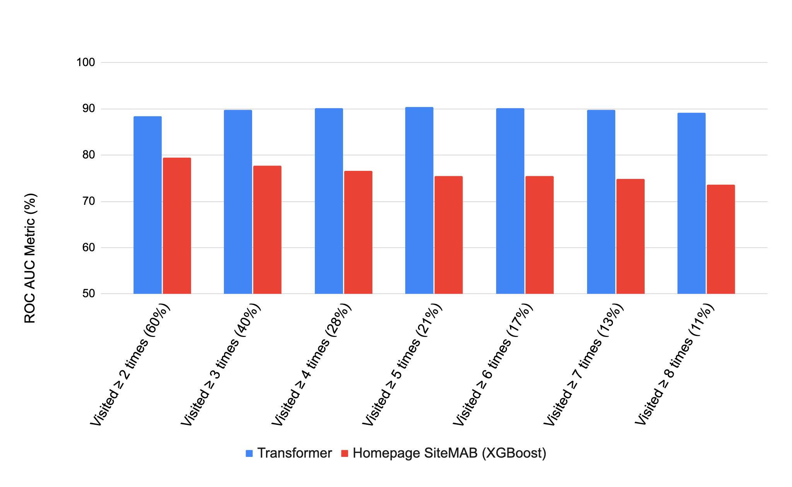
We employ NVIDIA’s Transformers4Rec library to show big recommendation improvements for repeat visitors to our homepage
Performance of Transformer POC model vs. existing model for Homepage

Slide 5
Agenda
Description of the problem
What is a Transformer? Rationale for it in Recommender Systems
Site personalization POC
Performance
Conclusion and future work
Notes:
Kal hands to Jesse

Slide 6
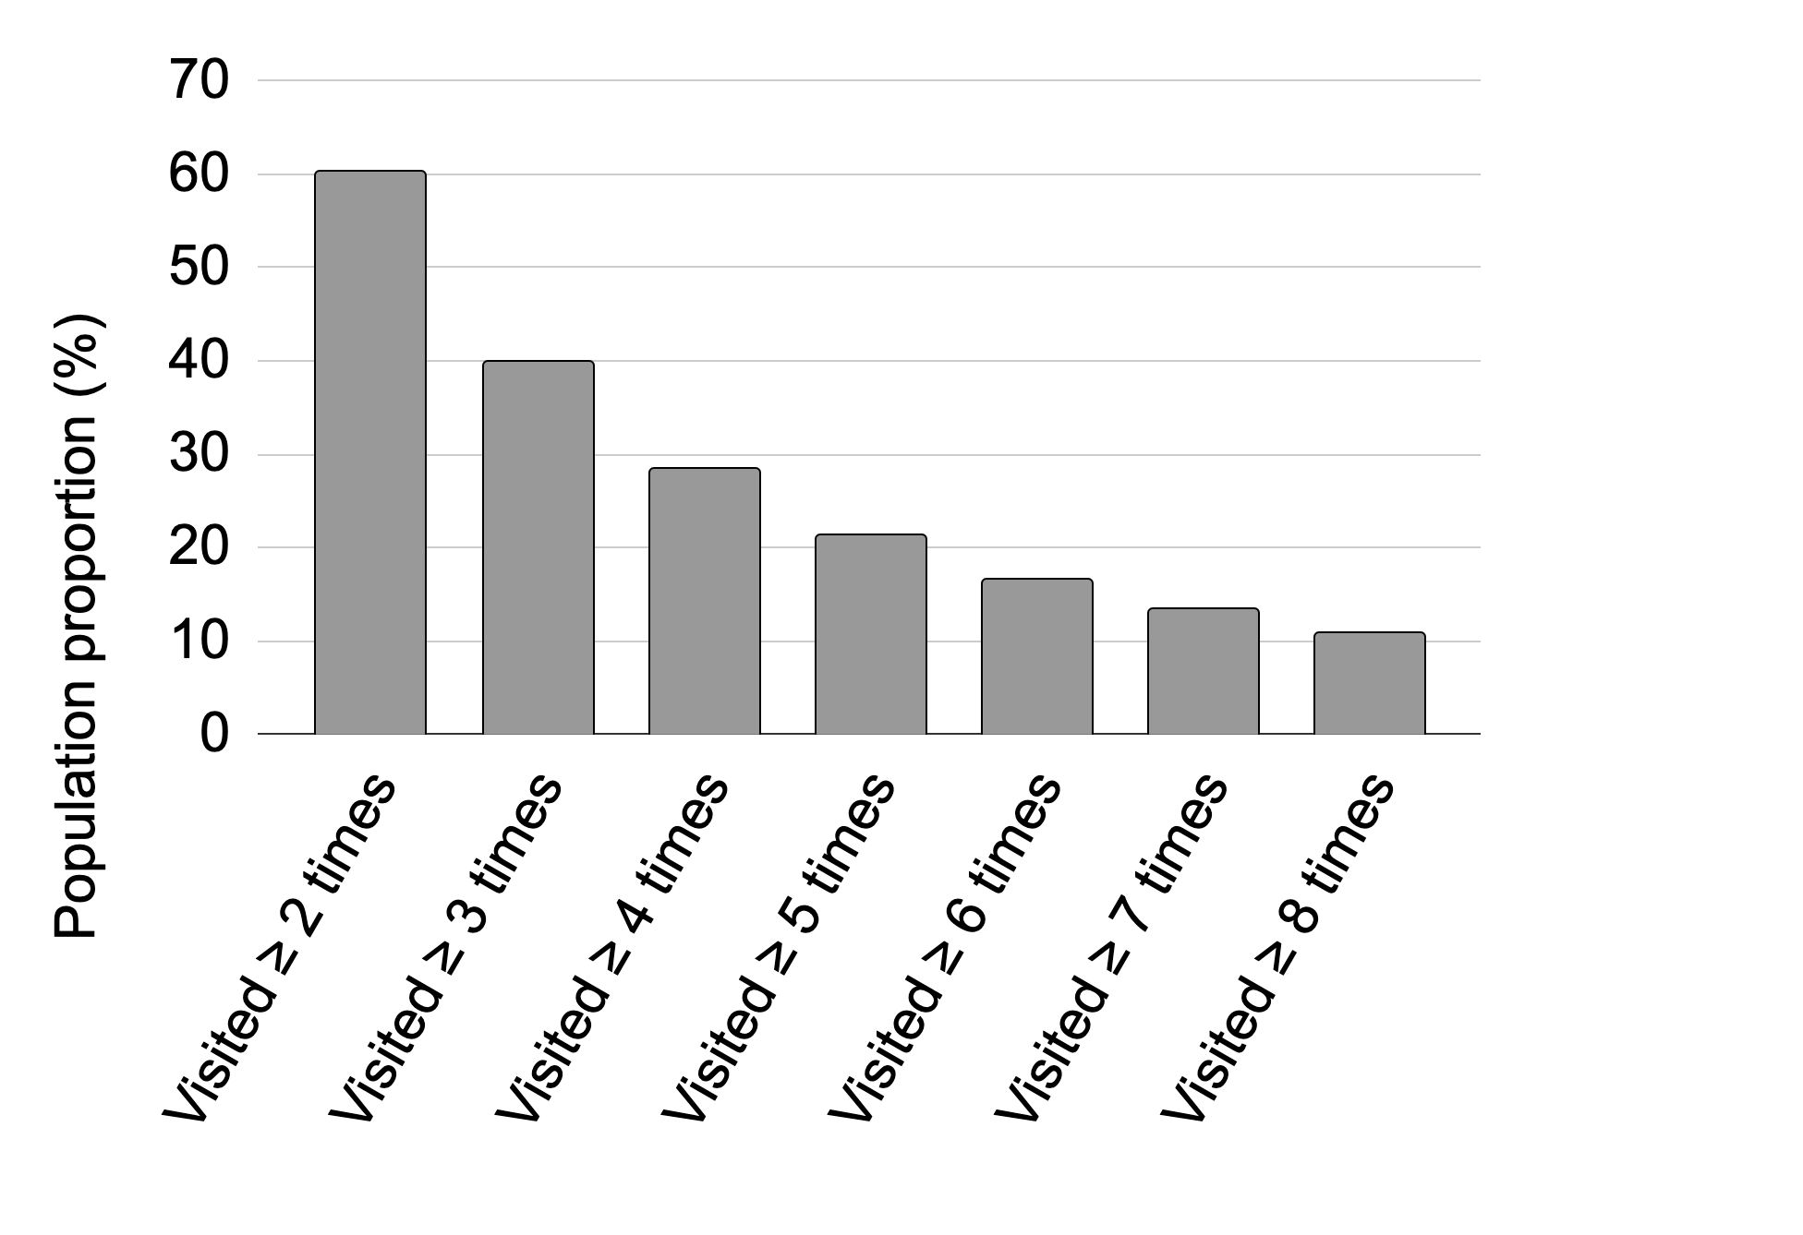
Repeat visitors are 60% of the Capital One’s homepage visitor population
Proportion of Customers Visiting The Site Multiple Times per Month

Slide 7
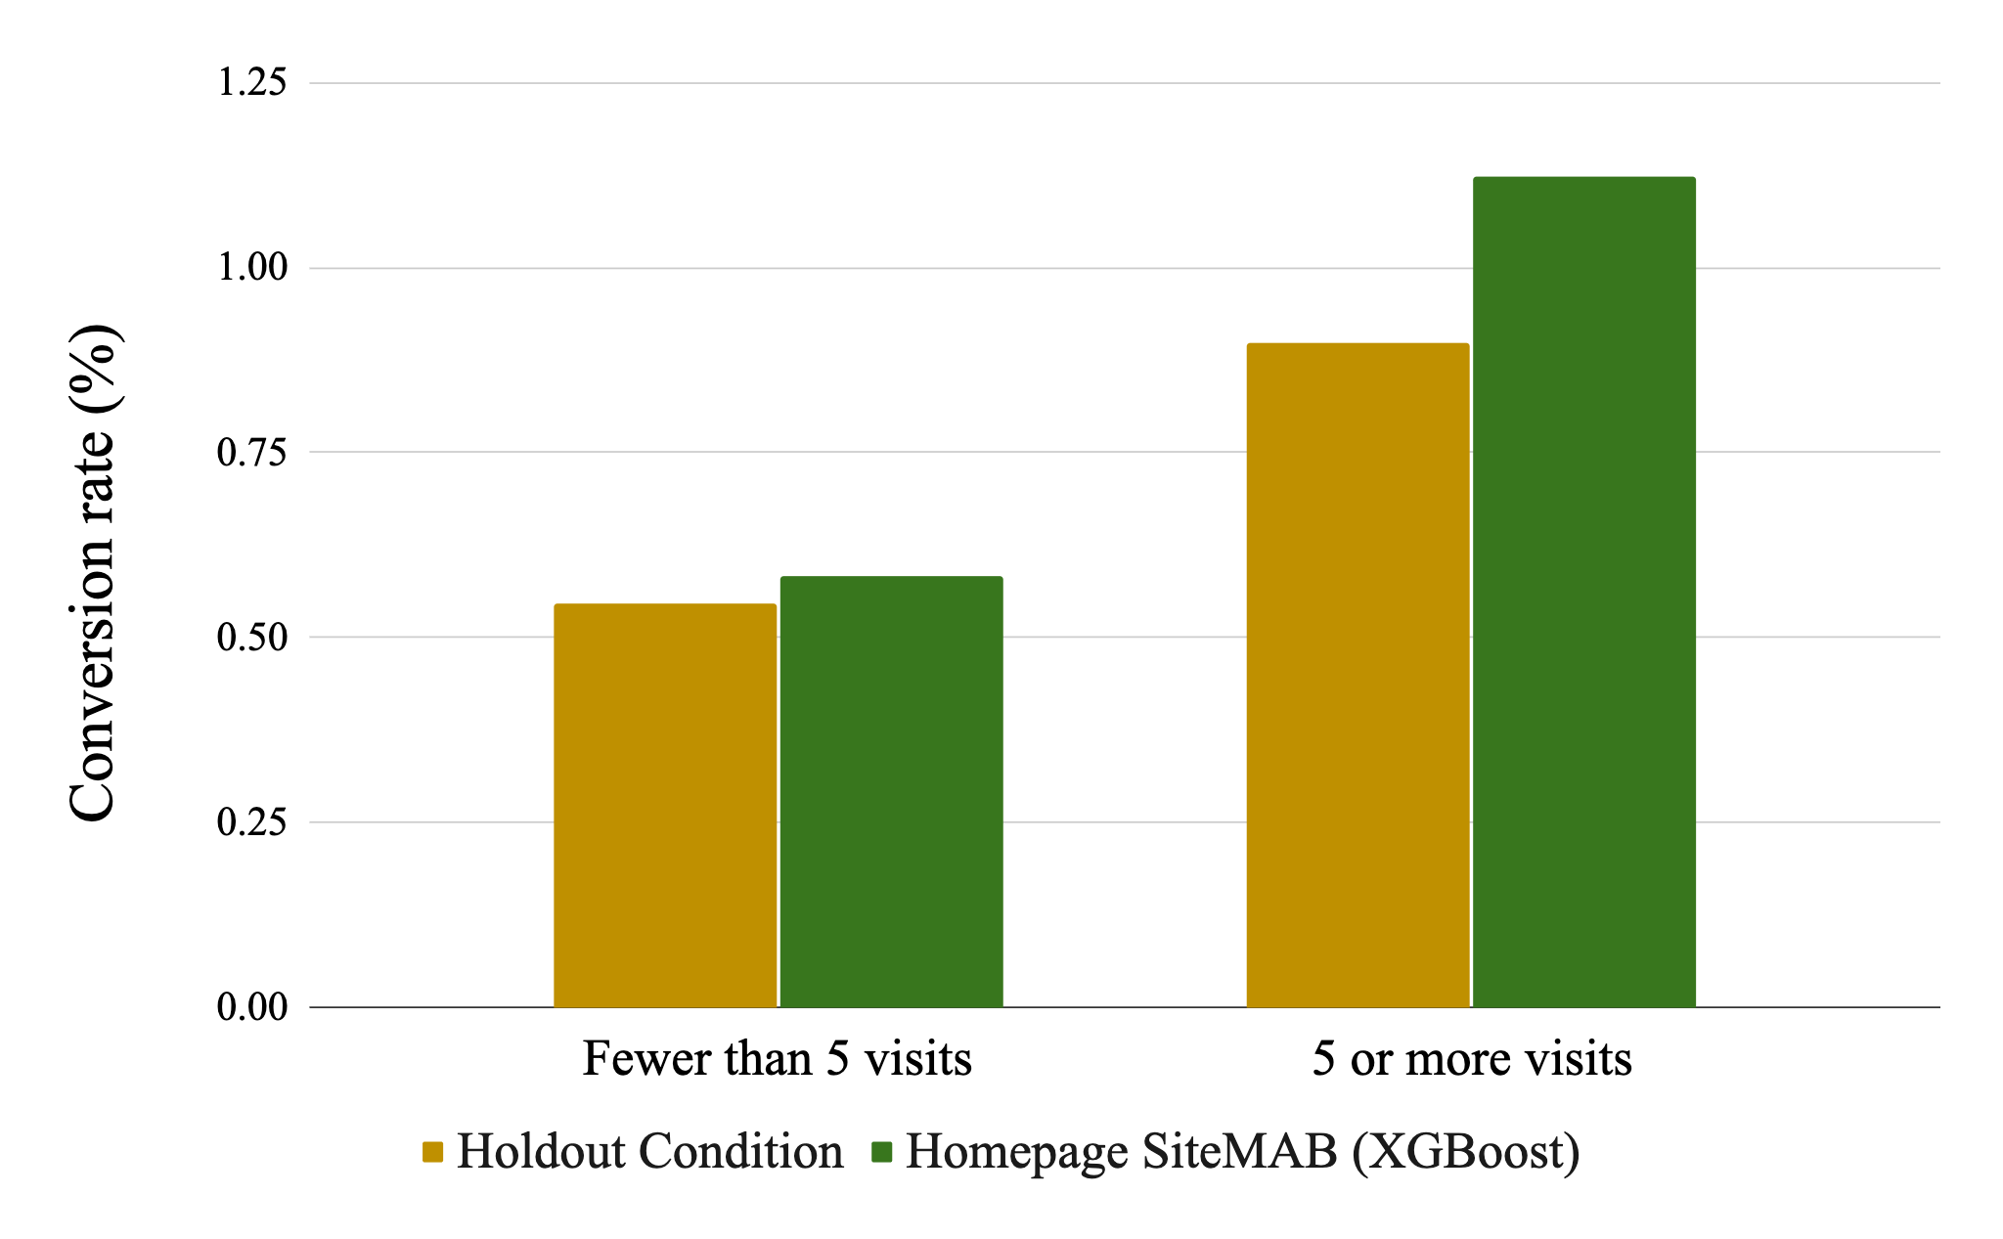
Frequent visitors convert at higher rates and are major drivers of lifetime value
Conversion Rate by Condition and Number of Visits

Slide 8
Our recommendation engine is a contextual multi-armed bandit with exploitation component consisting of an XGBoost model
Epsilon-greedy approach:
Random 5% of visitors are served random advertisement (exploration)
The rest are served a personalized experience powered by XGBoost (exploitation)
Day’s visitors react to served ads; model retrained the next morning with the new data
VentureX
Exploitation
(XGB-determined advertisement)
95%
360 Savings
Homepage visitors
...
Random split
MobileApp
…
5%
Exploration (random advertisement)

Slide 9



Our XGBoost model takes into account our visitors’ context, but does not capture visitor data as a sequence of experiences
Probability that Jane converts if she sees Banner 1
= 0.03
Input Space
Response
Date | Customer | Ad | Owns Card? | Convert
8/01/2022 | Jane | AutoNav | 1 | 0
8/02/2022 | Jane | Savings | 1 | 0
8/03/2022 | Jane | MobileApp | 1 | 0
8/04/2022 | Jane | VentureX | 1 | 1
Binary Classification(XGBoost)
Probability that Jane converts if she sees Banner 2
= 0.02
Ranked List of Banners
Session-Level Data Structure
… etc.
= 0.02
…
Train model to predict conversion based on input configuration
Score candidate ads based on trained parameters, pick highest scoring ad to show next

Slide 10
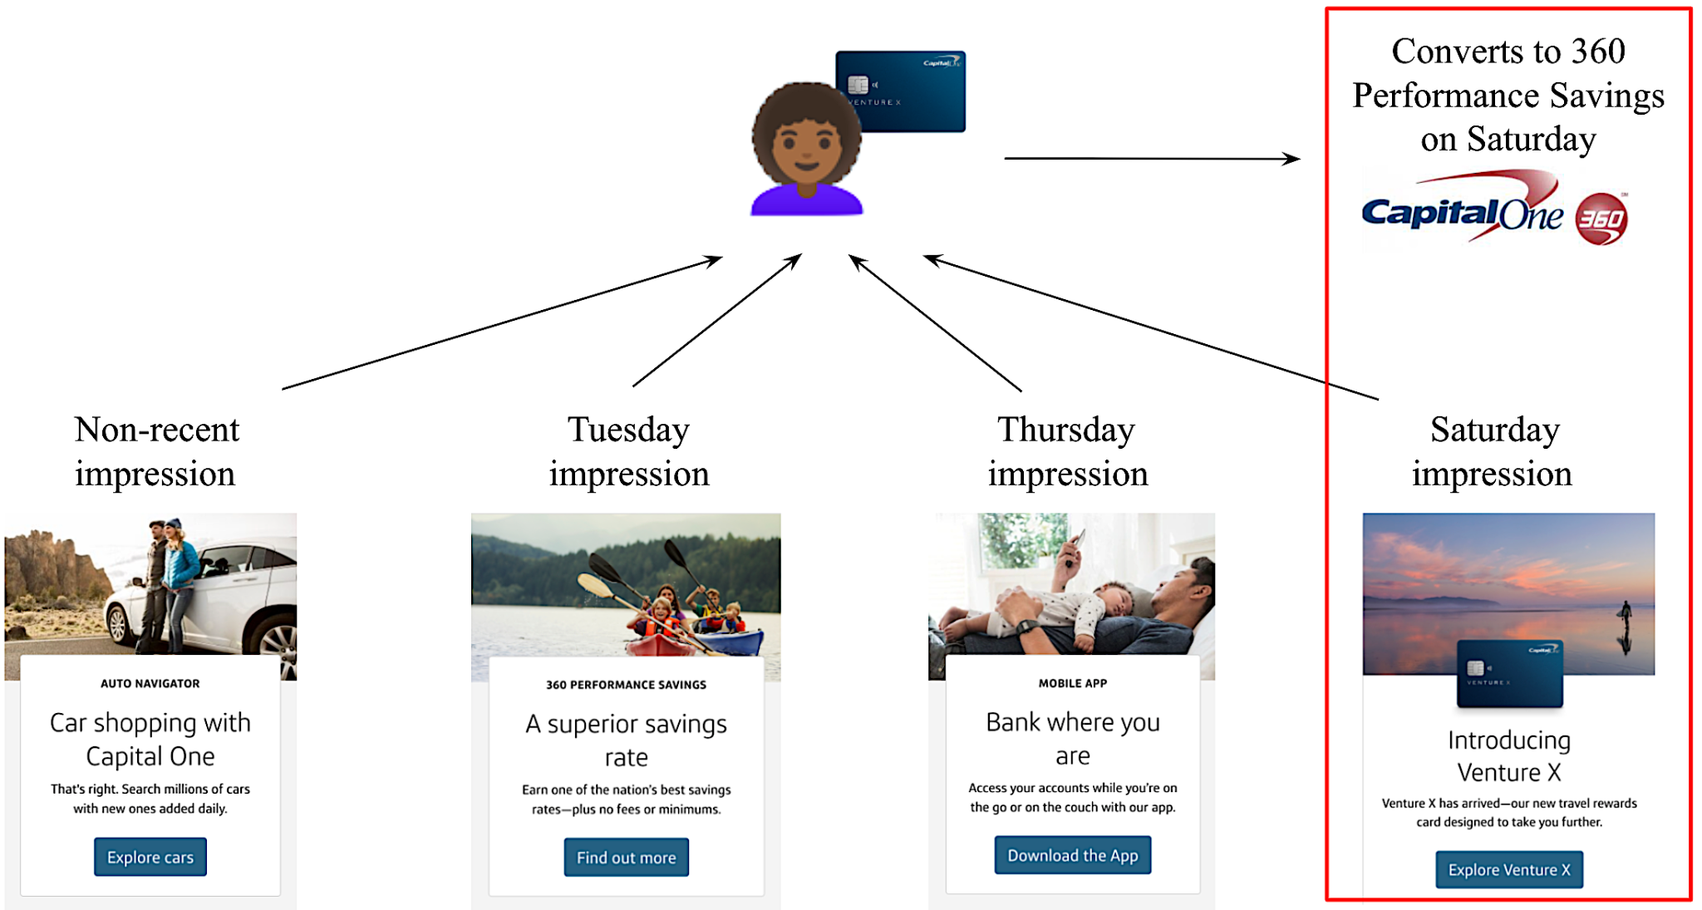
Our non-sequential model cannot learn which experiences in a visitor’s history were relevant to conversion, limiting its ability to serve the best ads
A naive model like ours credits conversion to the Venture X impression, rather than the 360 Savings impression. Ends up learning to show Venture X Card more to people who own a Venture X card!

Slide 11
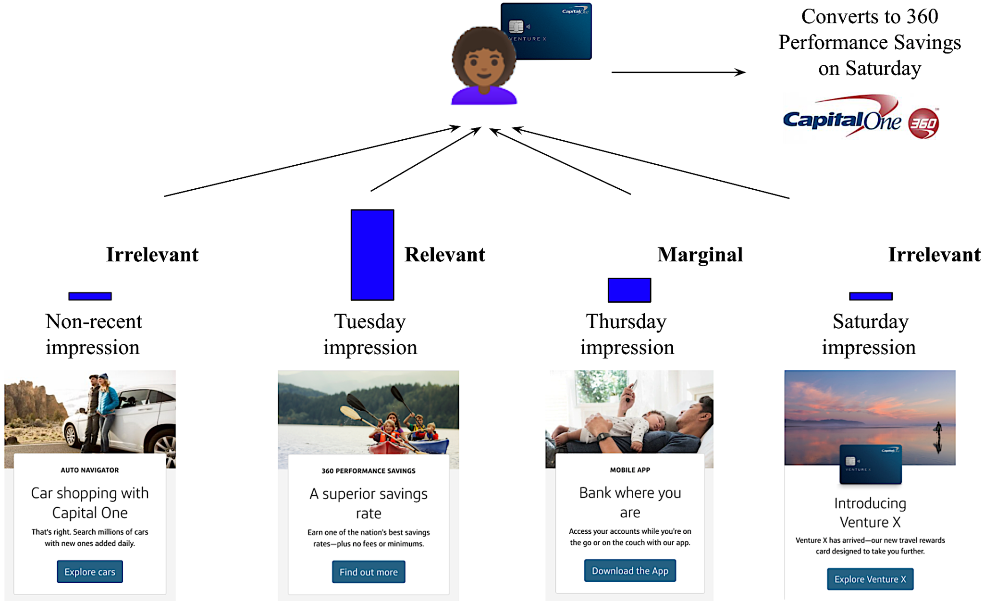
Sequence modeling would optimize for this population and serve the right banner to the right individual more often, stimulating lift
We want an algorithm that:
Keeps track of the temporal order of a visitor’s history
Learns how to credit their conversion to the appropriate prior experiences

Slide 12
Agenda
Description of the problem
What is a Transformer? Rationale for it in Recommender Systems
Site personalization POC
Performance
Conclusion and future work

Slide 13
The Transformer is a deep learning model from NLP – it uses Attention to learn how relevant a word is to sentiment in sentences with different contexts
Bakery Review
Rating
“The cake was so fluffy and tender that I loved it.” 👍
“The cake was so bittersweet that I hated it.” 👎
“The cake was so fluffy and sweet that I just hated to love it!” 👍

Slide 14
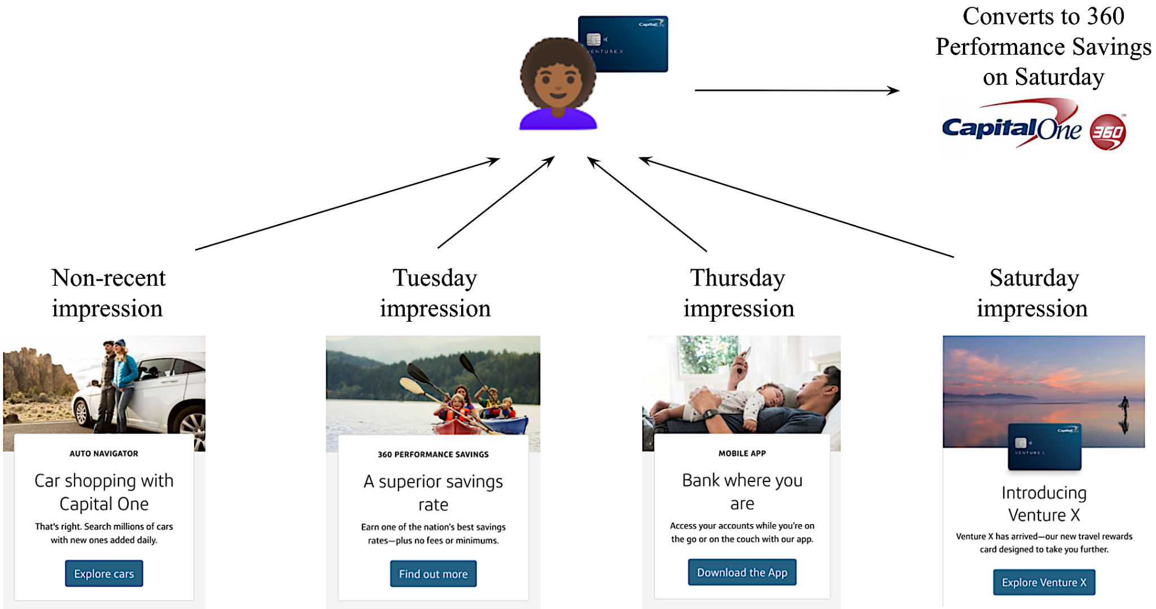
The same model can be used for personalized recommendation – to learn from Jane’s context and her sequence of experiences leading up to conversion

Slide 15


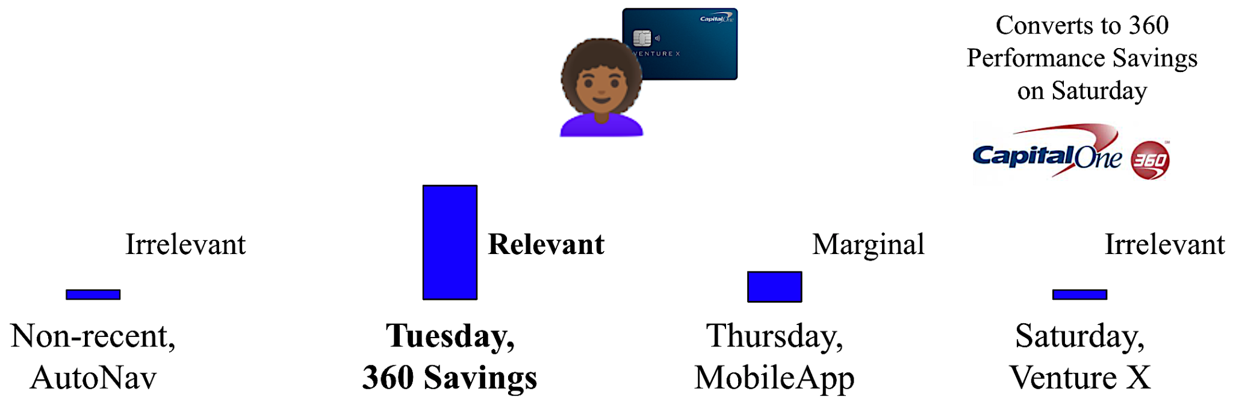


The Transformer can learn to pay attention to the most relevant experiences from Jane’s history, so as to serve better recommendations to visitors like her
Probability Jim converts if he sees Venture X
= 1%
Probability Jim converts if he sees 360 Savings
= 2%

Slide 16
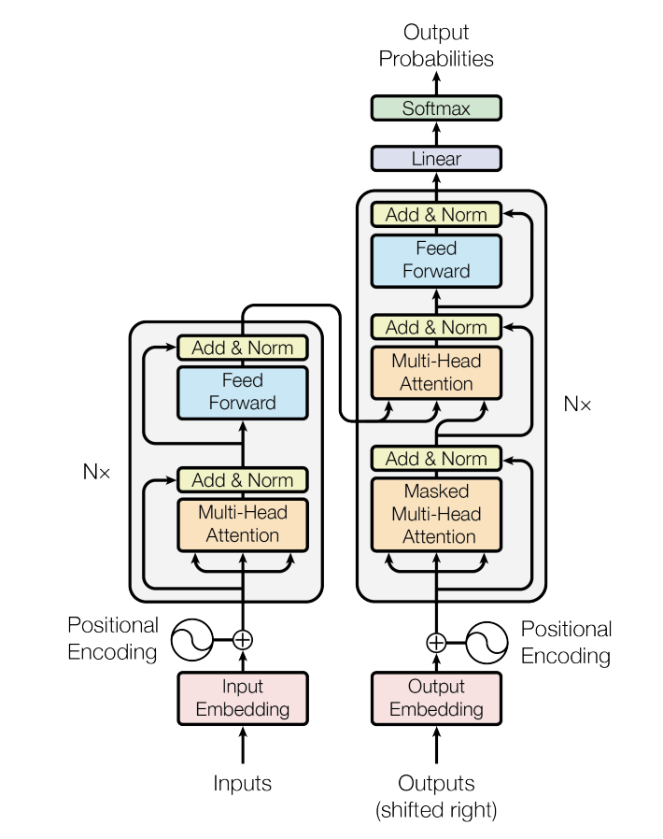
We employ the Attention-powered Transformer to solve the attribution problem
The Transformer (Vaswani et al. 2017) is a state-of-the-art algorithm from Deep Learning and NLP.
E.g., Yang et al. 2019 on text classification
Transformers have outperformed its competitors on various recommendation tasks:
Uses Attention to learn from data how to attribute visitor’s conversion to appropriate past experiences
See e.g. Sun et al. 2019, Kang et al. 2018
Attention-powered systems have outperformed competitors on attribution problems like ours:
See esp. Arava et al. 2018 on comparing RNNs w/ Attn against plain LSTM
Also Ren et al. 2018, Kumar et al. 2020, etc.

Slide 17
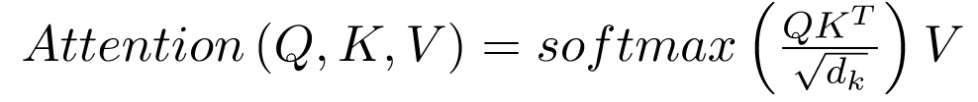
Brief overview of concepts underlying Transformers
Unlike RNNs, Transformers are non-sequential algo’s:
Relative ordering between sequential timesteps captured with positional encoding
Uses Self-attention mechanism to capture context / relevance of a timestep within broader sequence
Self-attention applied iteratively in stack of Attention blocks to capture higher-order interactions
Originally consisted of encoder & decoder — our model (ALBERT) is encoder-only
Our slides covering the basics of Transformers

Slide 18
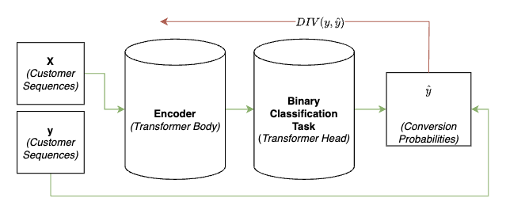
Our supervised training process differs from how Transformers are typically trained for NLP use cases
Though Transformers typically have a pretraining component and masking module, our framework has neither
Binary targets are explicitly passed in and modeled on directly
Transformer gets signal from divergence between true target and predicted label, rather than masked target and prediction over mask

Slide 19
Agenda
Description of the problem
What is a Transformer? Rationale for it in Recommender Systems
Site personalization POC
Performance
Conclusion and future work
Notes:
Jesse hands to Snehita

Slide 20
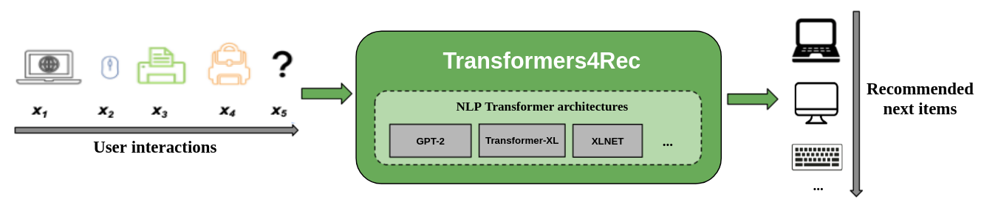



NVIDIA provides GPU-accelerated Deep Learning packages tailored for Recommender Systems
Conversion probabilities
0.7
0.6
…
0.9
We evaluated multiple packages - Transformers4Rec (NVIDIA), Recbole, Hugging Face
Transformers4Rec provides the most out-of-the-box capabilities:
Provides a classification framework that allows us to predict probabilities of conversion based on input features — other packages only provide next-item prediction framework
Integrates user feedback and contextual features
Modular nature gives us flexibility to design Transformer architecture for our unique needs

Slide 21
We built a Transformer-powered recommendation algorithm that employs NVIDIA’s Transformers4Rec package
Tokenizer
Model
Head
Data: SiteMAB data for Homepage (June 30 - August 10, 2021)
~ 50 features:
Previous Site impressions
Product ownership
Login count
Device type (Mobile, Tablet, Mac, etc.)
Browser type (Firefox, Safari, Chrome, etc.)
Bank page visits
Card page visits
Model input
Embeddings
Layers
Hidden states
Head
Model output
Raw sequences
Input IDs
Logits
Predictions
[venture, 360 cc, auto]
[101, 231, 3456, 456]
[-4.3630, 4.6859]
Conversion Probability: 99.89%
Image adapted from Hugging Face Transformers Course

Slide 22
For data preprocessing we use NVIDIA’s NVTabular to make use of GPU powered acceleration
T4rec and NVTabular are part of NVIDIA’s Merlin ecosystem that allows for end-to-end GPU-Accelerated and Distributed pipelines.
NVTabular, as part of the NVIDIA Merlin ecosystem, is a wrapper over the RAPIDS Dask-CuDF library.
Allows for GPU-Accelerated data operations like transformations, aggregations, slicing & padding.
It takes us from a tabular representation, like the one we currently model on (SiteMAB), to a sequential one.
Input Space
Response
Input Space
Response
Date | Customer | Banner | Day of Week | Convert
8/01/2020 | 1 | 1 | 1 | 0
8/02/2020 | 1 | 2 | 2 | 0
8/03/2020 | 1 | 3 | 3 | 0
8/04/2020 | 1 | 4 | 4 | 1
NVTabular
(GPU-
Accelerated Data Operations)
Latest Date | Customer | Banner Sequence | DayOfWeek Sequence | Convert
8/04/2020 | 1 | <1,2,3,4> | <1,2,3,4> | 1
Customer-Level Data Structure
Session-Level Data Structure

Slide 23
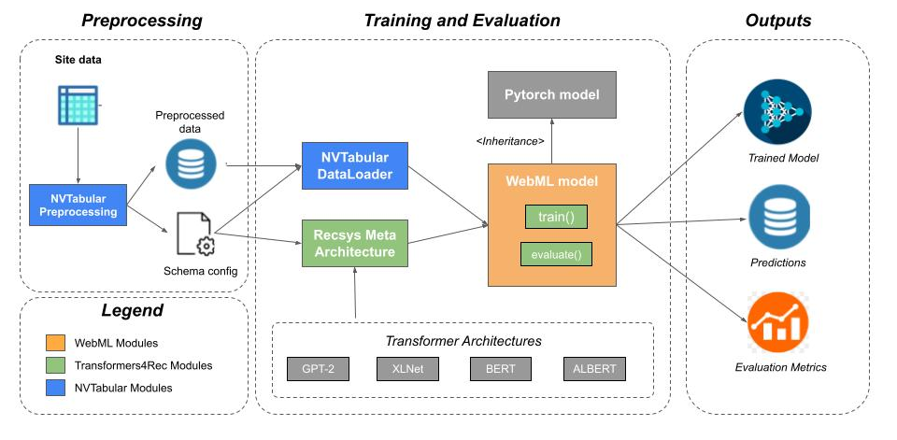
Overview of our end-to-end Transformer POC pipeline
POC uses Legoland instances with NVIDIA V100 GPUs with 256 GB memory, processing units that feature the Volta architecture

Slide 24
Despite its size and complexity, the Transformer can be used for daily batch scoring or real-time scoring
 | Partition Type | Train Size | Test Size | Fitting Time | Evaluation Time | Scoring Time (12 variants - like SiteMAB)
ALBERT 16 heads 12 layers Dimension of embedding = 64 Epochs per iteration = 20 | 80% train (downsampled* 50/50) 20% test (unsampled) Partitioned by day | 100k customers | 2M customers | ~30 minutes ~3.8k customers per minute | ~5 minutes ~344k customers per minute | ~4.25 hours** to score 50mm customers daily - 8 V100 Instance Distributed Inference ~200k customers per minute
* Downsampling required for two reasons:
Fit is relatively slow otherwise (need multi-GPU)
Transformer struggles with class imbalance (i.e., the fact that only ~0.1% of customers convert)
** This includes operations to ‘enrich’ feature vectors to predict at t+1

Slide 25
Agenda
Description of the problem
What is a Transformer? Rationale for it in Recommender Systems
Site personalization POC
Performance
Conclusion and future work

Slide 26
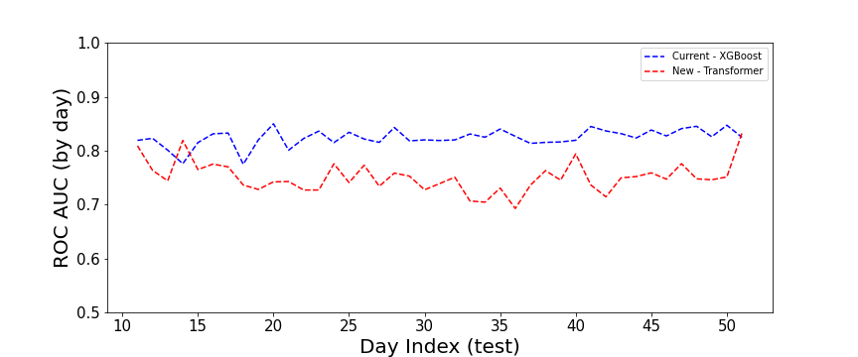
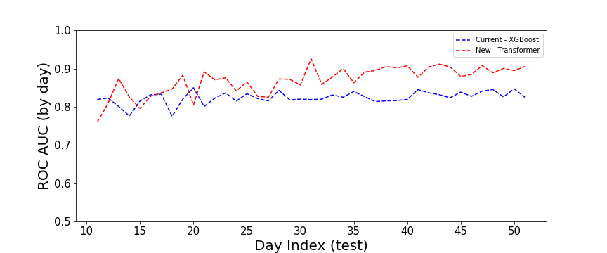
In our POC, we tested the Transformer against our current model and measured performance across two segments of Site users
Segment #1
single-visit users (40% of sample)
Segment #2
repeat-visit users (60% of sample)
Transformer underperforms existing model when a user lacks enough history to compose a sequence
Does not exhibit trends of learning throughout time
Performance improves over time
Some warm up period needed, with large lift thereafter
~2 weeks into test

Slide 27
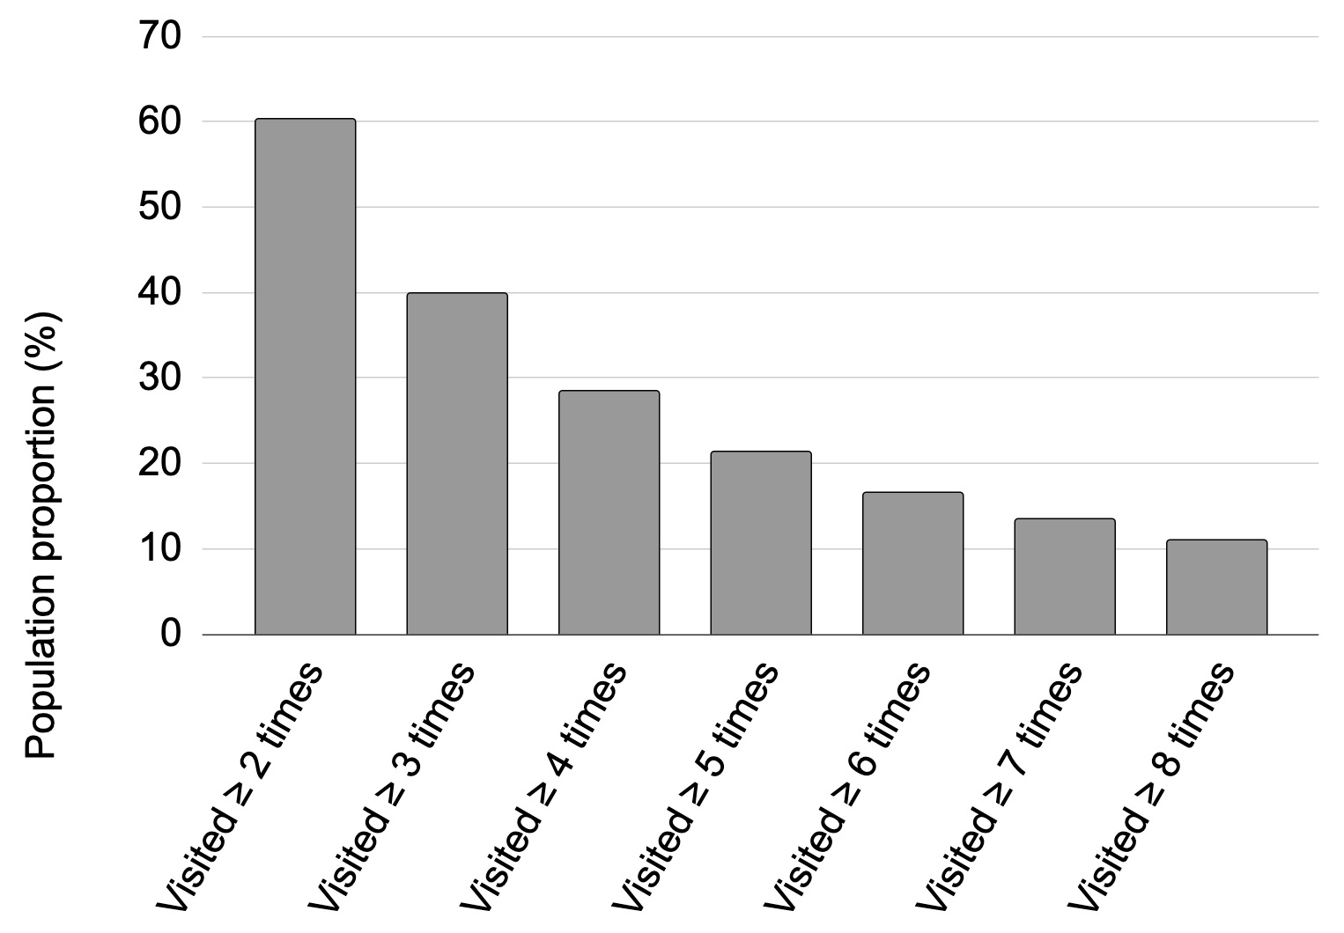
Across the segment of repeat visitors, the sequence-capable model outperforms the baseline algorithm by a wide margin
Number of Visits | Transformer ROC AUC | XGBoost ROC AUC
≥ 2 | 0.88 | 0.80
≥ 3 | 0.90 | 0.78
≥ 4 | 0.90 | 0.77
≥ 5 | 0.90 | 0.75

Slide 28
Agenda
Description of the problem
What is a Transformer? Rationale for it in Recommender Systems
Site personalization POC
Performance
Conclusion and future work

Slide 29
Conclusion and future work
In our POC, we replaced XGBoost with NVIDIA’s Transformers4Rec framework
Transformer learns to credit a visitor’s conversion to appropriate prior experiences, unlocking sequenced data for classification
Work under progress today:
Apply Transformers4Rec to Capital One authenticated space
Pipeline to map sequenced data to embeddings, to use as features in flat models
Work with NVIDIA to enable multi-GPU training
Look into click sequence, webpage visit sequence, etc.
Some more theoretical lines of future work:
Compare against LSTM, LSTM w/ Attn. (cf. Arava et al. 2018)
Model absolute timestep rather than relative ordering (Li et al. 2020)
Compare incremental vs. batch learning
Explore how same / similar system can be used for performance reporting

Slide 30

Acknowledgment
We thank Jacob Dineen (now a CS graduate student at Arizona State University) for invaluable assistance throughout the engineering process

Slide 31
Thank you!

Slide 32
Appendix

Slide 33
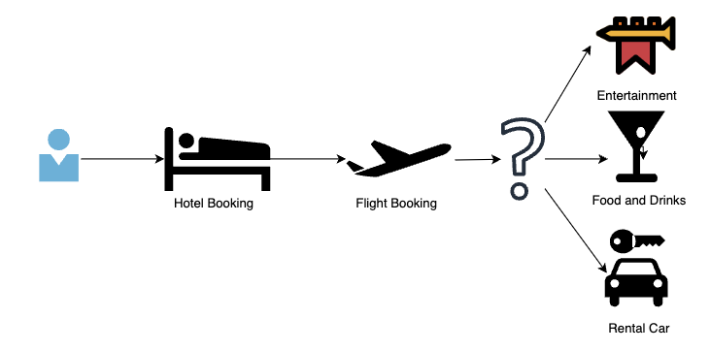
Transformer4Rec’s popular use case is next-item prediction, but ours is classification
NextItemPrediction is the most popular use-case for T4Rec:
Show ad of product you think they will book next based on products booked in recent past
CapOne customers do not usually book multiple products in quick succession
Instead, we need to classify a sequence of experiences (e.g., impressions) as ending in a conversion or not
Then we score ads w/ probability of conversion based on learned parameters, picking highest-scoring ad to show next
Notes:
Speaker: Jesse, Next: Jesse

Slide 34
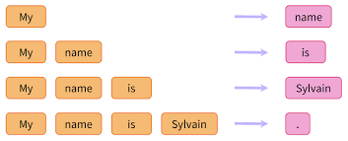
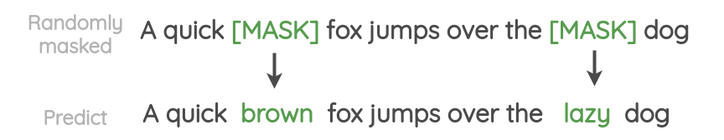
The training procedure differs between the general language case and our application of Transformers
In general, language models are pretrained (self-supervised learning) on a large corpora of text with a specific task
Encoder models usually have the task of masked language modeling (MLM)
Decoder models usually have the task of casual language modeling (CLM)
Pretrained models are then fine-tuned on downstream tasks, like question answering, sentiment analysis, autocompletion, etc.
Masked Language Modeling: Randomly masking some percentage of the input data and ‘filling in the blanks’
Causal Language Modeling: Predicting the next token following a sequence of tokens
MLM & CLM
Notes:
Speaker: Jesse, Next: Jesse
Self attention studies relationship between two elements in every possible pair of timesteps across sequence
Adds residual connections and applies layer norm’n after attention head as well as after the feed-forward layer

Slide 35
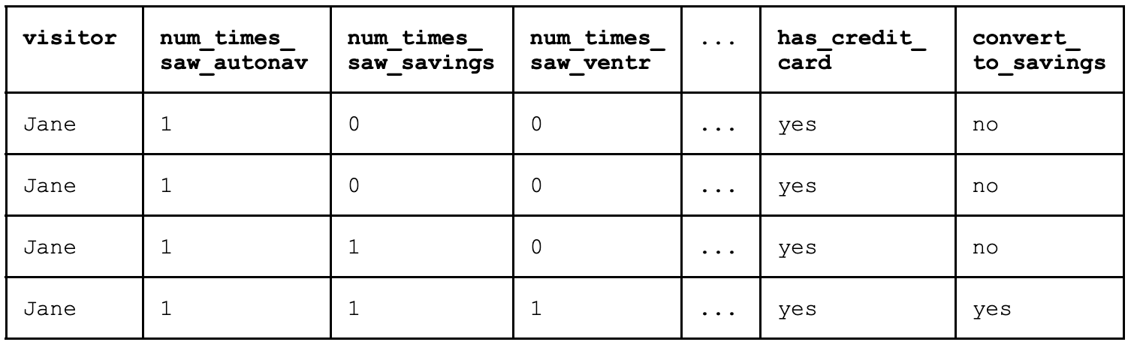
“Pooled” crediting strategy fails to capture impression recency
Accumulate # past impressions for each banner as we move down timesteps, with no signal of recency
Poor strategy for frequent visitors, esp. those that come to Homepage 8 or more times (> 10% population, significant source of lift)

Slide 36
Tracking which impression was seen at which previous timestep explodes the number of features and leads to training inefficiency
Features for…
Most recent visit: saw_ventr_frst_rcnt, saw_savings_frst_rcnt, …
Second-most-recent visit: saw_ventr_scnd_rcnt, saw_savings_scnd_rcnt, …
Third-most-recent visit: saw_ventr_thrd_rcnt, saw_savings_thrd_rcnt, …
… etc.
Suppose AutoNav banner is best for a small population across every timestep:
Fewer data points on COAF conversions
Model needs lots of data at each timestep to mimic time-insensitive generalization
Need algorithm that shares generalizations (i.e., parameters) across timesteps

